Slide 1
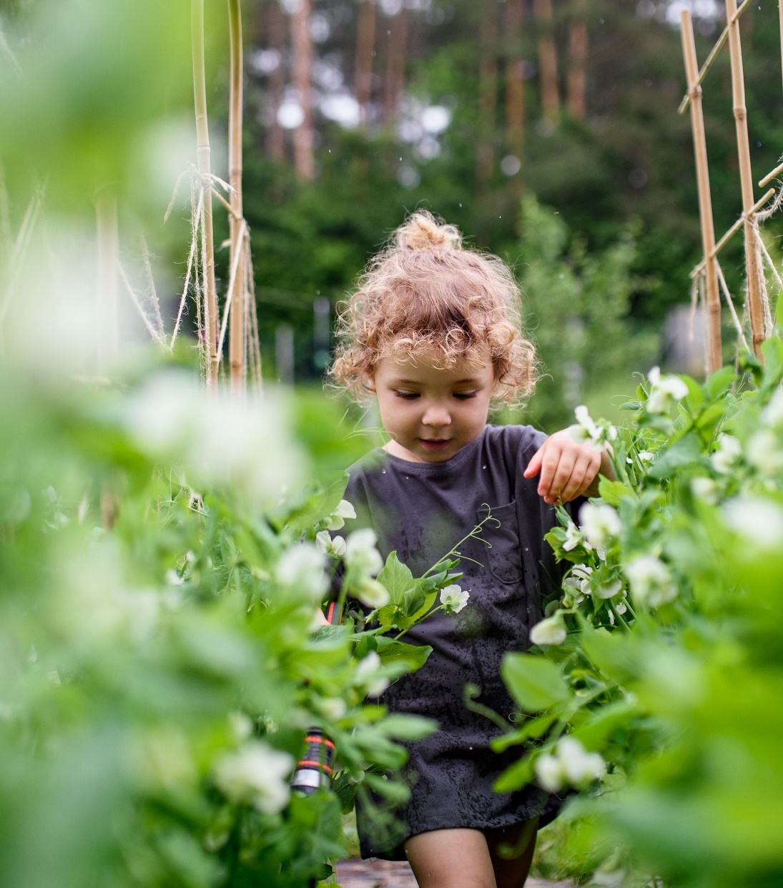
A competitive bioeconomy for a sustainable future

Slide 2

A competitive bioeconomy for a sustainable future
Advancing a competitive bioeconomy for a sustainable future
CBE JU is funding projects that deliver bio-based solutions – materials and products made from waste and biomass – in an innovative, sustainable and circular way
01

Slide 3


A competitive bioeconomy for a sustainable future
Launched in 2021, operates until 2031
Circular Bio-based Europe Joint Undertaking
€2 billion public-private initiative
Part of Horizon Europe programme
European Union
Represented by the European Commission
+
Contributing to the European Green Deal
Building on the success of its predecessor BBI JU
02
Notes:
Represented by the European Commission
DG RTD
DG AGRI
DG GROW
Large companies
SMEs
Universities
Technology platforms
Associations
Regional Clusters
Public Institutions
RTOs

Slide 4










A competitive bioeconomy for a sustainable future
Established by the Council regulation (EU) 2021/2085 of 19 November 2021
ADOPTION PROCESS
Along with 8 other institutionalised partnerships
03

Slide 5



A competitive bioeconomy for a sustainable future
CBE JU general objectives
Accelerate the innovation process and development of bio-based innovative solutions
Accelerate market deployment of the existing mature bio-based innovative solutions
Ensure a high level
of environmental performance of bio-based industrial systems
06

Slide 6




A competitive bioeconomy for a sustainable future
CBE JU specific objectives
Increase the intensity of cross-disciplinary research and innovation activities for the development and demonstration of sustainable bio-based solutions
Increase and integrate the R&I capacity of stakeholders across the European Union to exploit the local bioeconomy potential
Increase the R&I capacity for addressing environmental challenges and developing more sustainable bio-based innovations
Reinforce the integration of bio-based R&I processes in EU industrial value chains
Reduce R&I investment risk in bio-based companies and projects
Ensure that environmental considerations are taken into account in the development & implementation of
R&I bio-based projects
07

Slide 7
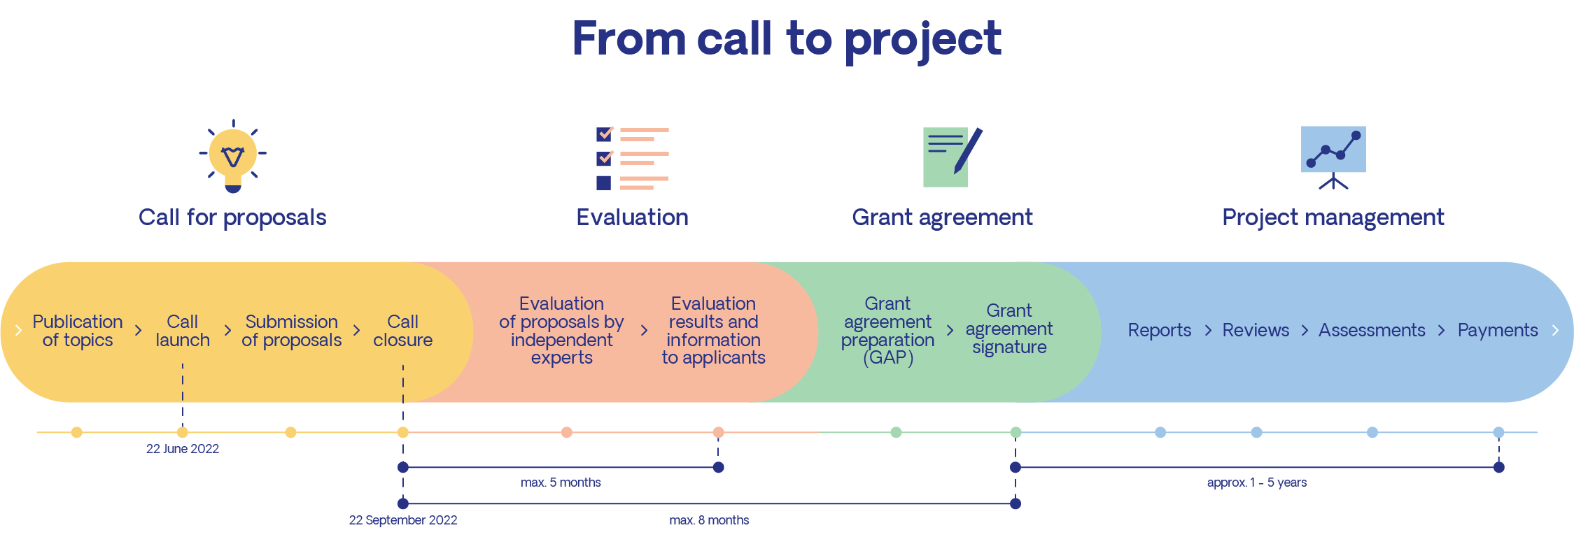
A competitive bioeconomy for a sustainable future

Slide 8


A competitive bioeconomy for a sustainable future
Large-scale first-of-its-kind product facility in Europe
Types of supported actions
Scale up and demonstration
of technologies
Development and validation of technologies
3
4
5
6
7
8
1
2
9
RIA Research and Innovation Actions
IA Innovation Actions (including Flagships)
Technology Readiness Level (TRL)
CSA: Coordination and Support Actions (no link with TRLs)
11

Slide 9

A competitive bioeconomy for a sustainable future
Supporting the European Green Deal
Contributing significantly to the 2030 climate targets, paving the way for climate neutrality
by 2050
Developing and expanding the sustainable sourcing and conversion
of biomass into
bio-based products
…Supporting the deployment of
bio-based innovation regional level, with a view to reviving rural and coastal regions
Increasing the sustainability and circularity of production and consumption systems
05

Slide 10
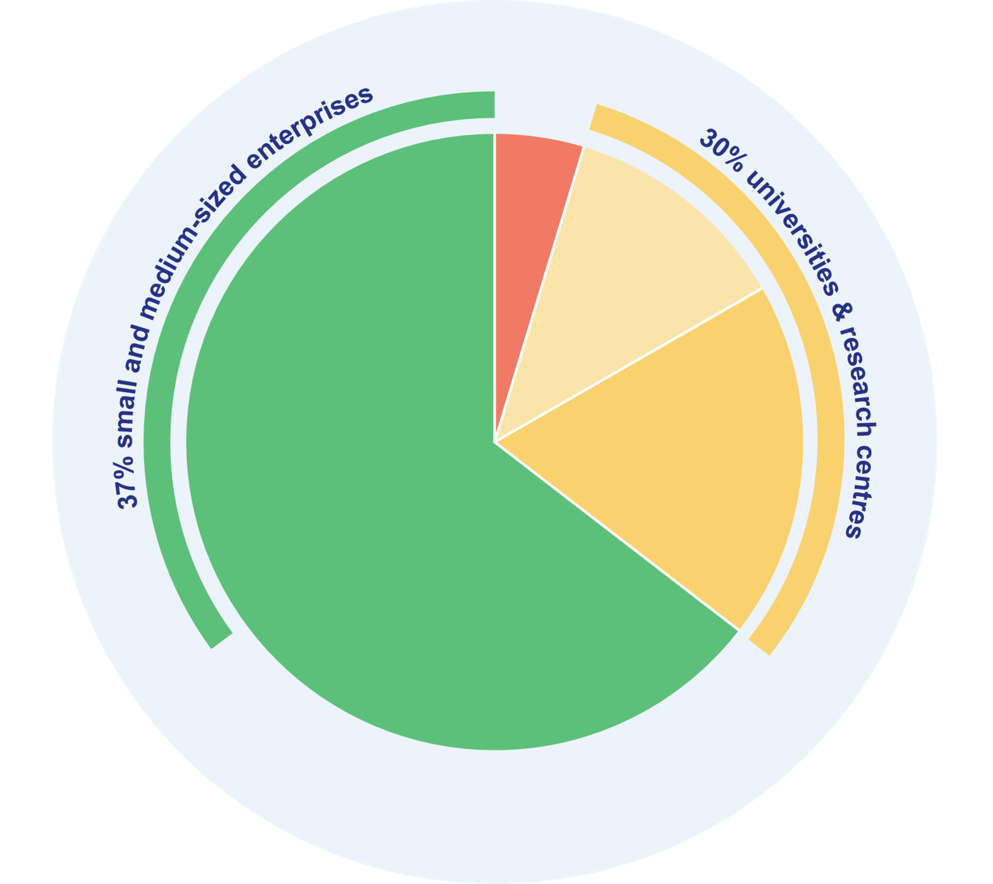



A competitive bioeconomy for a sustainable future
Building on the success of BBI JU
2014-2020
5.3%
142 projects
BBI JU funding per type of beneficiary
11.5%
1,055 beneficiaries
Private companies
18%
Research organizations
€822 million BBI JU funding
65.2%
Higher education establishments
Other
39 countries
Data: CORDA, June 2021
04

Slide 11
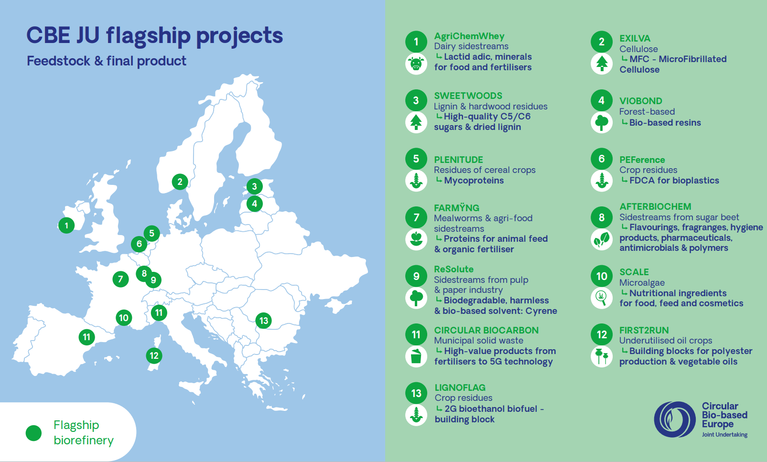

Slide 12
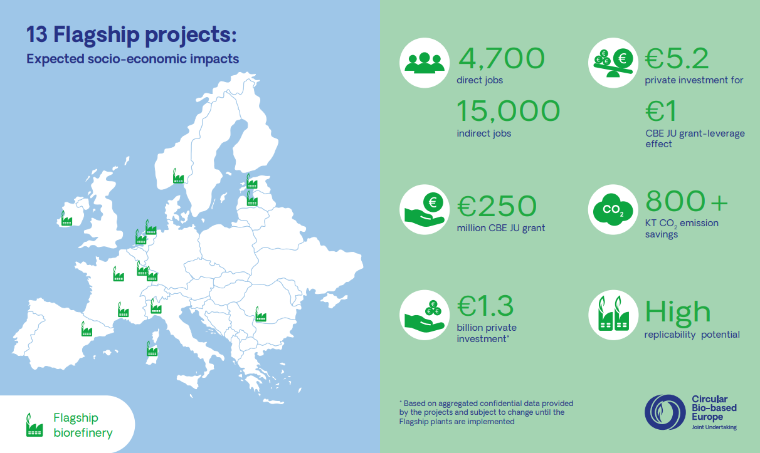

Slide 13

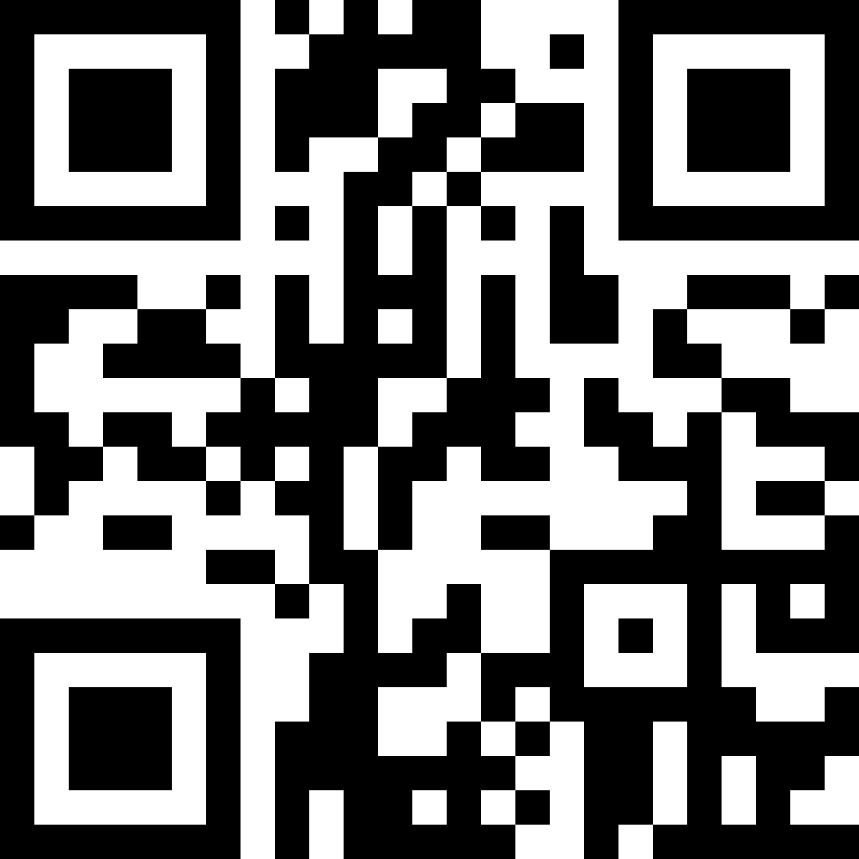
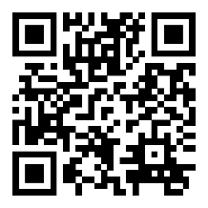
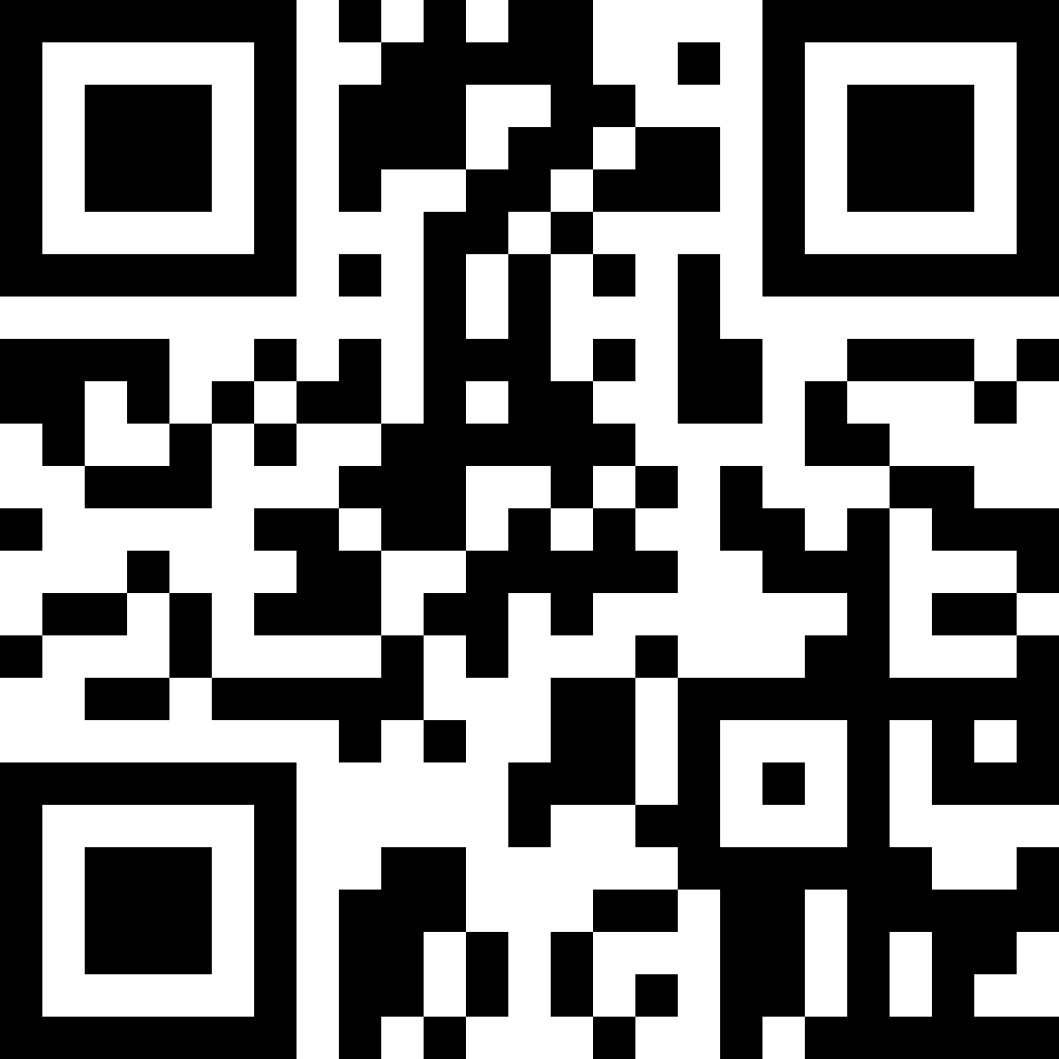
A competitive bioeconomy for a sustainable future
More information
Subscribe to
CBE JU newsletter
Become a BIC Member
Horizon Europe Funding and Tender portal
cbe.europa.eu
biconsortium.eu
europa.eu/!jH76RF
13

