Slide 1
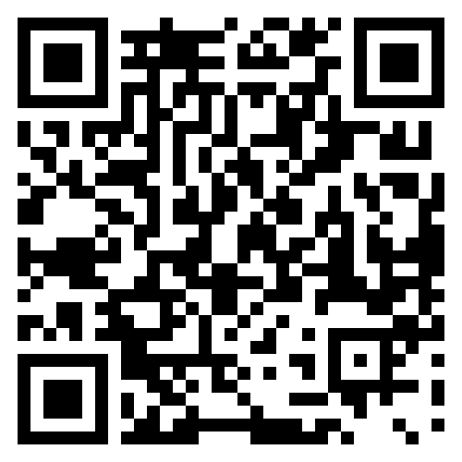

CBE JU
Info Day 2024
Scan & register
23 April, Brussels
#CBEInfoDay
I have registered for the CBE JU Info Day!

