Slide 1
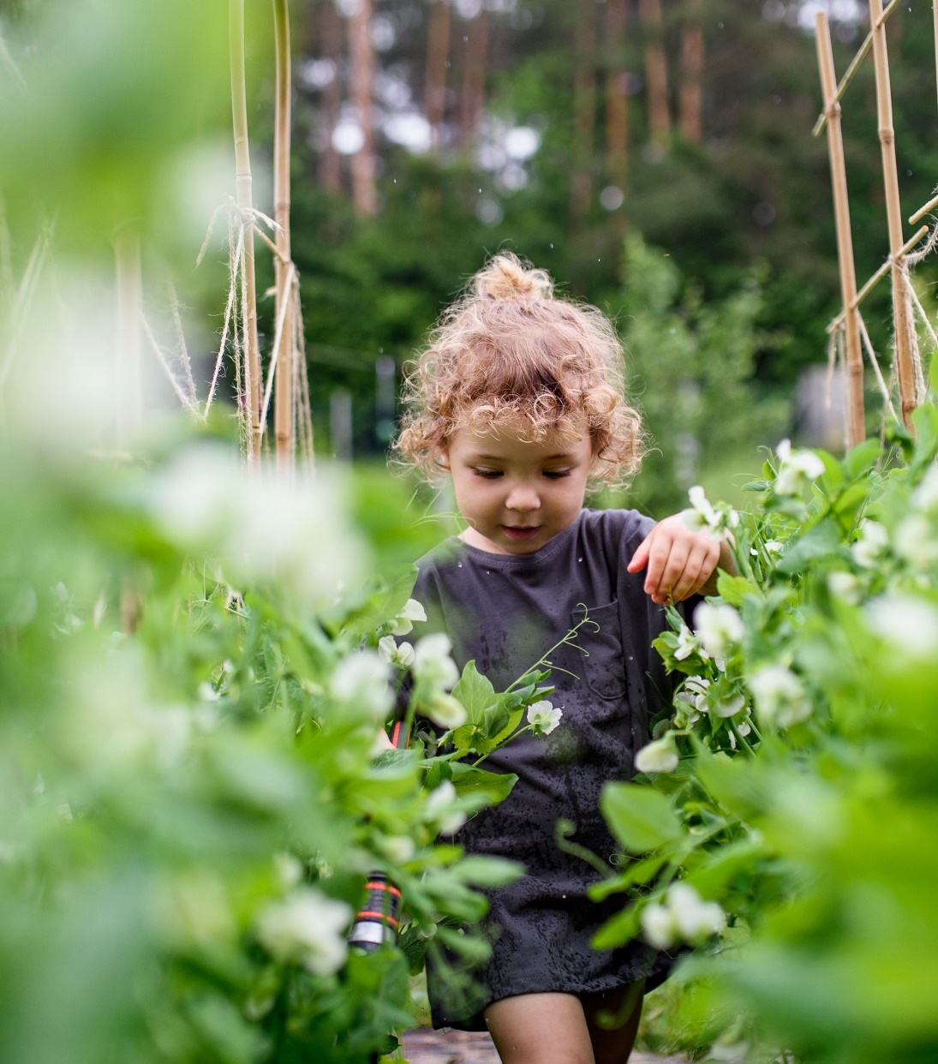
A competitive bioeconomy for a sustainable future

Slide 2


Launched in 2021, operates until 2031
Circular Bio-based Europe Joint Undertaking
Part of Horizon Europe programme
€2 billion
European Union
Represented by the European Commission
public-private initiative
advancing a competitive bioeconomy for a sustainable future
+
Supporting European bioeconomy
Building on the success of its predecessor BBI JU
Notes:
Represented by the European Commission
DG RTD
DG AGRI
DG GROW
Large companies
SMEs
Universities
Technology platforms
Associations
Regional Clusters
Public Institutions
RTOs

Slide 3






CBE JU specific objectives
Increase the intensity of cross-disciplinary research and innovation activities for the development and demonstration of sustainable bio-based solutions
Increase and integrate the R&I capacity of stakeholders across the European Union to exploit the local bioeconomy potential
Increase the R&I capacity for addressing environmental challenges and developing more sustainable bio-based innovations
Reinforce the integration of bio-based R&I processes in EU industrial value chains
Reduce R&I investment risk in bio-based companies and projects
Ensure that environmental considerations are taken into account in the development & implementation of
R&I bio-based projects

Slide 4
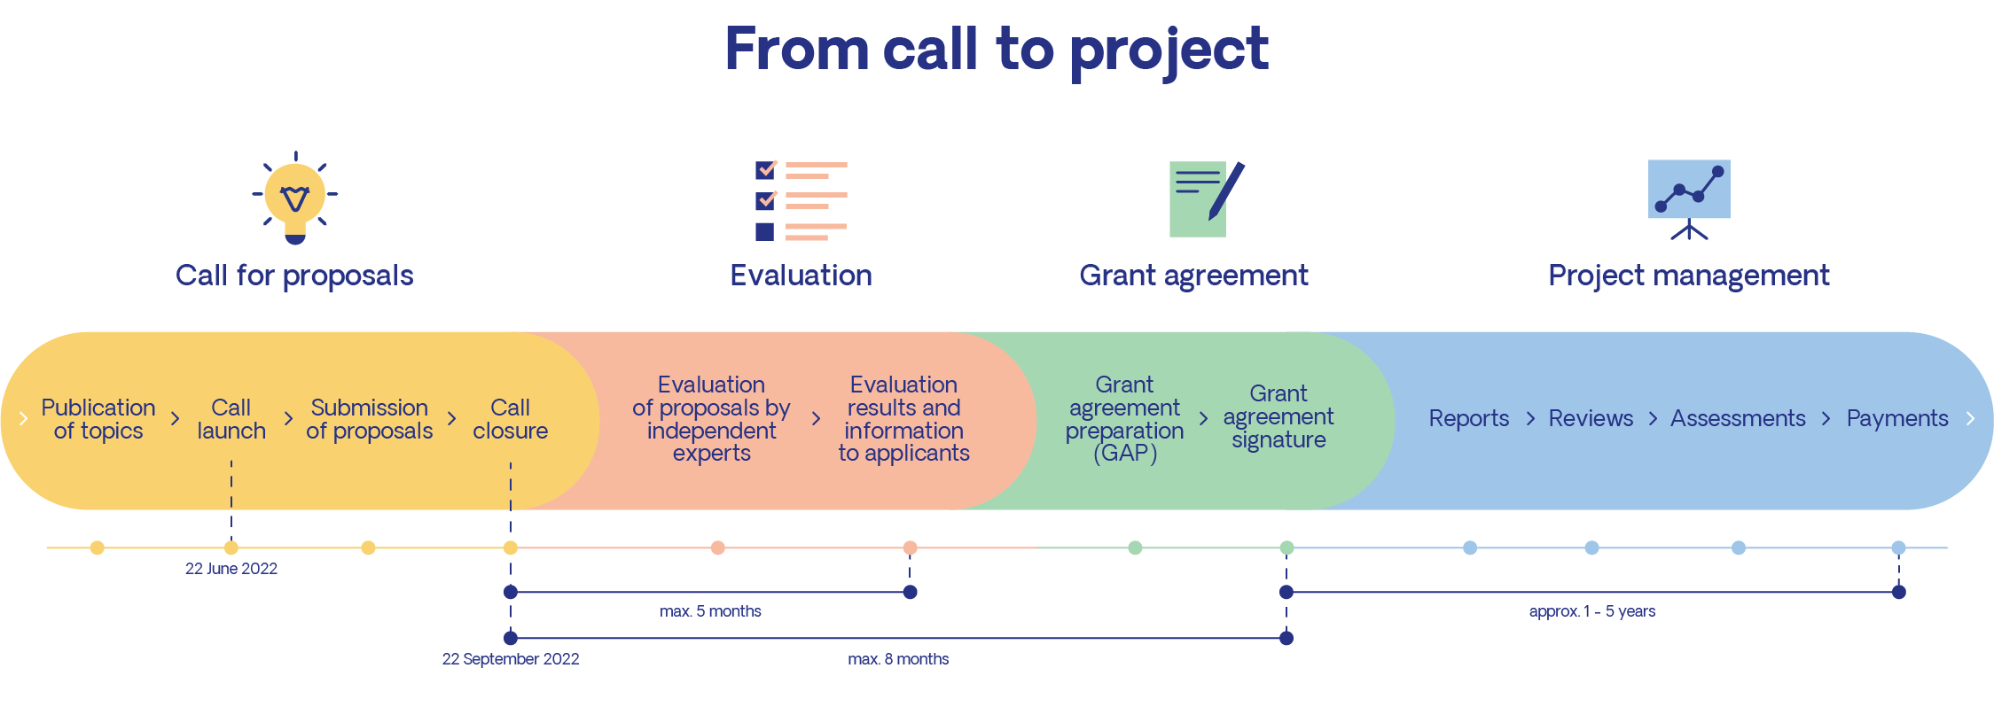
From call to project

Slide 5


Large-scale first-of-its-kind product facility in Europe
Types of supported actions
Scale up and demonstration
of technologies
Development and validation of technologies
3
4
5
6
7
8
1
2
9
RIA Research and Innovation Actions
IA Innovation Actions (including Flagships)
Technology Readiness Level (TRL)
CSA: Coordination and Support Actions (no link with TRLs)
11

Slide 6
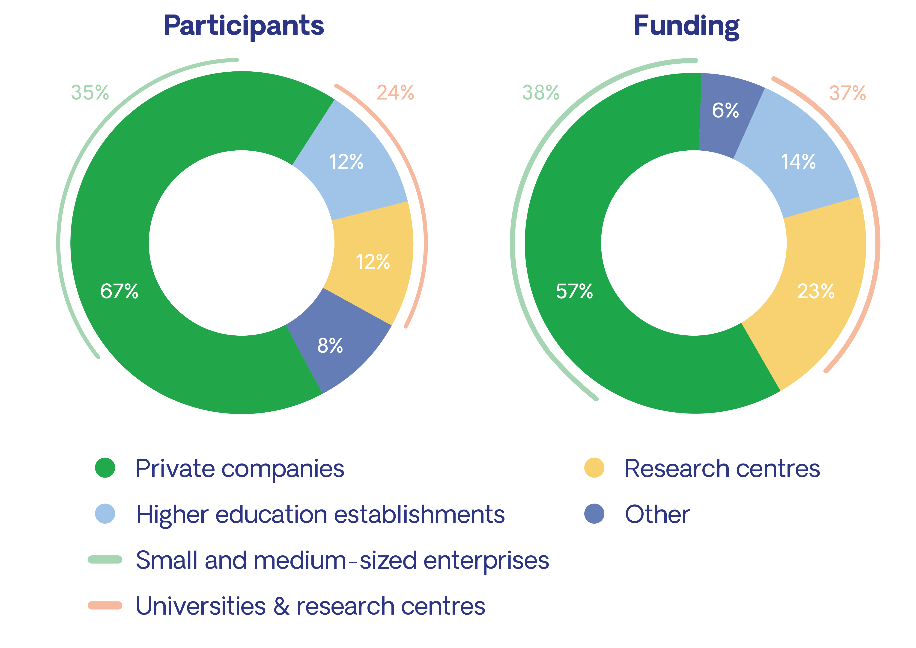



CBE JU-funded projects in numbers
2014-2025
220 projects
1,700 participants
€1.3 billion invested in projects
45 countries
Data: CORDA, June 2025

Slide 7



Main feedstock types
AQUATIC
AGRI-FOOD
FOREST-BASED
18 projects
60 projects
43 projects
Forest-based
&
Agri-food
&
Organic waste
Organic waste
&
Forest-based
Aquatic
&
Agri-food
Agri-food
2 projects
2 projects
2 projects
ORGANIC FRACTION OF MUNICIPAL SOLID WASTE
Agri-food
&
Other
4 projects
31 projects
10 projects
OTHER
BIOGENIC GASEOUS CARBON
SIDESTREAMS FROM INDUSTRY
9 projects
6 projects
8 projects

Slide 8






Areas of applications
)
Construction
Textile
s
(
s
B
e
u
n
s
i
in
s
e
u
s
B
16
9
s
-
-
o
T
T
projects
o
-
projects
-
s
C
s
e
o
n
n
i
s
s
Bio-based chemicals
u
u
Food, feed & cosmetics
Packaging
B
m
(
e
r
)
B2B
37
25
B2C
47
projects
projects
projects
Bio-based materials
Crop protection and fertilisation
40
12
projects
projects

Slide 9







CBE JU-funded Innovation Actions
6
3
Flagship biorefinery
7
1
Demonstration plant
4
4
2
9
14
6
11
2
1
14
5
2
1
8
1
36
20
5
Number of projects per country

