Slide 1
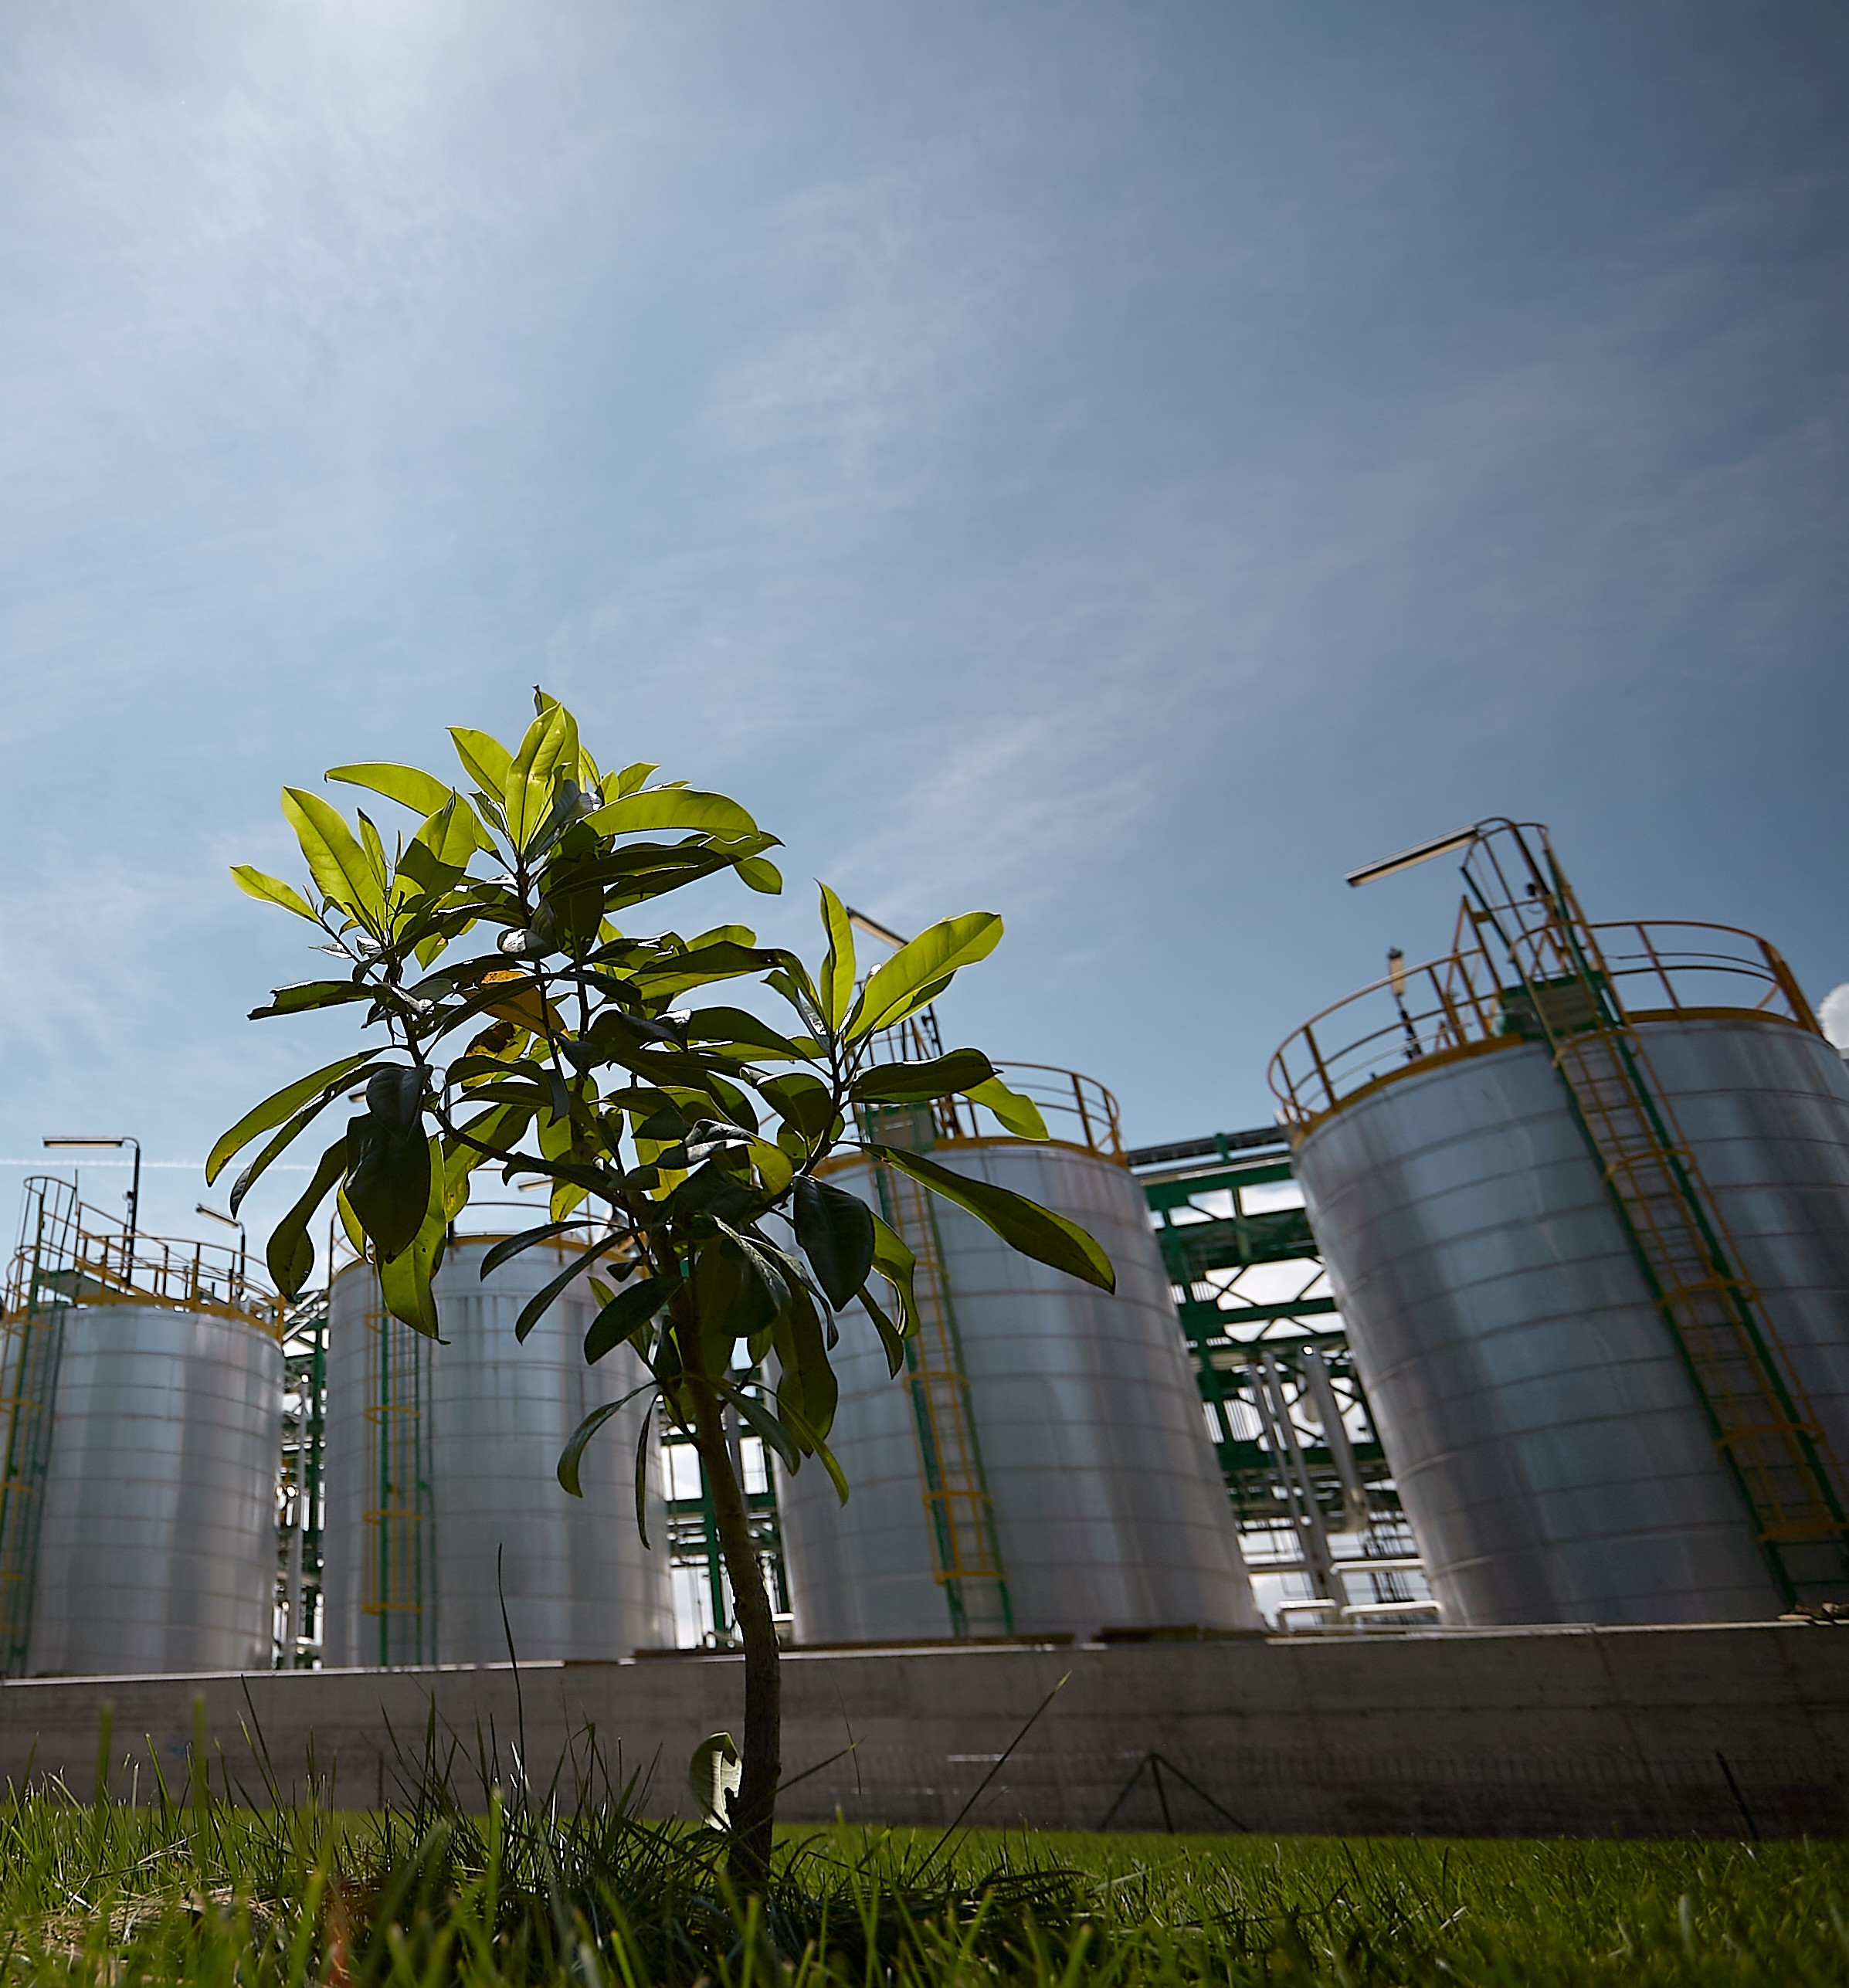
A competitive
bioeconomy for a
sustainable future
© RUNFASTER4EU - Versalis

Slide 2


Circular Bio-based Europe Joint Undertaking
€2 billion
public-private partnership
scaling up Europe’s circular bio-based industries
Boosting Europe’s competitiveness
Decarbonising industries
Cutting fossil imports
Waste
to value
Supporting EU’s sustainability objectives
Notes:
CBE JU is partnership between the EU and the private sector that funds scaling up Europe’s circular bio-based industries.
These industries convert renewable resources, often waste and residues, into sustainable high-added value bio-based materials and products. This helps:
Decarbonising major European production sectors, such as packaging, construction, textile, food and feed.
Boosting Europe’s competitiveness not only in innovation but also in its industrial deployment. This is important for small businesses that can scale up, primary producers who can diversify their business with alternative income sources, and ultimately regions across Europe benefitting from the development of local economy.
Strengthening Europe’s independence from fossil imports by offering locally sourced & produced bio-based alternatives, for instance bio-based fertilisers and pesticides.
Addressing EU’s sustainability objectives with circular production processes and innovative products, for instance alternative proteins.
Which of these topics are you most interested in?
How CBE JU helps decarbonising European industries
How CBE JU boosts European competitiveness
How CBE JU supports Europe’s strategic autonomy
How CBE JU aligns with the EU sustainability objectives

Slide 3



Driving investments in bio-based innovation
2014-2025
243
projects
€1
€109 million
Italian government investment
EU funding
€3.5
private investments
1.44 billion
invested in projects
11 plants
across the country
350+
associated members
400+
industry members
Notes:
CBE JU has so far invested a total of €1.4 billion in 243 projects.
The public funding comes from the Horizon Europe R&I programme. Each euro of EU funding triggers 3.5 euros in private investments.
The private founding member, BIC, has grown to 400+ industry members and 350+ associated members. Industry members include 75 large companies, 120+ SMEs, 80+ microenterprises and 103 SME clusters (representing an more than 90 additional SMEs). BIC also has over 350 Associate Members including Research and Technology Organisations (RTOs), universities, European associations and organisations. Technology Platforms (ETPs), public institutions, regional organisations and private banks.
In this way, BIC brings together an authoritative pool of cross-sector and multi-disciplinary expertise in the field of bio-based industries. BIC’s industrial members have all committed to invest in collaborative research, development and demonstration of bio-based technologies within the CBE JU.
EMBRACED example of attracting additional funding: The CBE JU-funded EMBRACED demonstration project was successfully completed in December 2022 proving that used absorbent hygiene products - nappies, feminine hygiene products, and incontinence pads - can be turned into valuable bio-based materials, fertilisers, and bioplastic through an innovative biorefinery approach. In 2025, the Italian government decided to invest over €109 million from its National Recovery and Resilience Plan to replicate this model in a new biorefinery infrastructure across the country. First of 11 such biorefineries was inaugurated in Treviso in July 2025.

Slide 4

Key partner for scale-up
Led to a €700 million private investment for a commercial-scale biorefinery in Latvia
New WOODCELL project builds on success of SWEETWOODS
Notes:
CBE JU funds projects that bridge the gap between laboratory research and industrial-scale deployment — the hardest and most expensive stage of innovation. We often refer to this gap as the ‘two valleys of death’: first, research to demonstration for a start-up to bring a prototype to an industrial demonstration plant, and second, demonstration to full commercial scale, to bring a successful demonstrator to a first-of-its-kind full commercial-scale production.
First-of-their-kind biorefineries face a structural financing problem: banks and investors won't fund what has never been built before. CBE JU absorbs early-stage risk, making projects bankable and helping attract private co-investment at scale.
CBE JU has so far invested in 22 such first-of-their-kind biorefineries across Europe, with a high replication potential in other regions and sectors. Close to 200 demonstration plants have also been established.
SWEETWOODS example: shortly after the SWEETWOODS flagship project’s completion in May 2024, its lead company Fibenol from Estonia announced the construction of a new commercial-scale biorefinery in the neighbouring Latvia to start in 2027 and generate around 100 direct and 600 indirect jobs in the region. The planned biorefinery has already been granted national priority investment project status and access to fast-track Green Corridor services.
The WOODCELL flagship project, started in June 2024 and led by Fibenol, will scale up the production of Fibenol´s specialty cellulose (MCC), a low-carbon natural bio-based material with unique properties. The project aims to collaborate across value chains to replace fossil-based chemicals with low CO2 bio-based alternatives.
CBE JU shows that targeted public investment can unlock multiple capital sources and keep that investment in Europe.
Additional data:
Since 2014, 1,860 participants from 46 countries have benefitted from CBE JU funding.

Slide 5











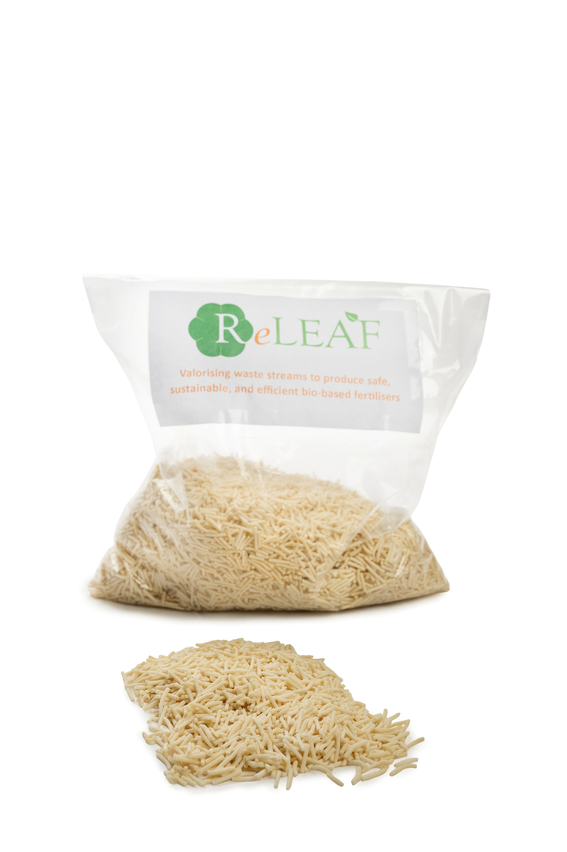

Decarbonising industries & cutting imports
Packaging
Textile
Cosmetic & personal care
Construction
Bio-based polymers
& plastics
Food & feed ingredients
Automotive
Plastics
Chemicals
Agriculture
Furniture
The ReLEAF project is developing bio-based fertilisers from waste streams like sewage sludge, fish processing waste and wastewater, mixed food waste, and agri-food residues.
The project will decrease reliance on imported materials by up to 20%, while preventing microplastics release in soil.
Crop protection
and fertilisation
Notes:
CBE JU works on replacing fossil inputs with European biomass, sector by sector.
Bio-based industries replace petroleum-derived chemicals, plastics and materials with equivalents made from renewable European feedstocks.
This directly reduces both greenhouse gas emissions and the volume of fossil raw materials imported from outside the EU.
CBE JU supports this transition across chemicals, packaging, construction, textiles, automotive sector and more.
Fertilisers example: Bio-based fertilisers can replace a great share of synthetic nutrients for plants. They also contribute to reducing reliance on fossil fuels, which are essential for the traditional fertilisers. Studies indicate that substituting just 20-40% of synthetic fertiliser use can significantly reduce costs during price spikes while bringing environmental benefits. In addition, their local production limits exposure to global supply chain disruptions, making them a strategic asset for agricultural resilience and food security.
The ReLEAF project is developing bio-based fertilisers from waste streams like sewage sludge, fish processing waste and wastewater, mixed food waste, and agri-food residues. In addition to the project’s ambition to decrease reliance on imported materials by up to 20%, the new bio-based fertilisers will prevent microplastics release in soil.

Slide 6
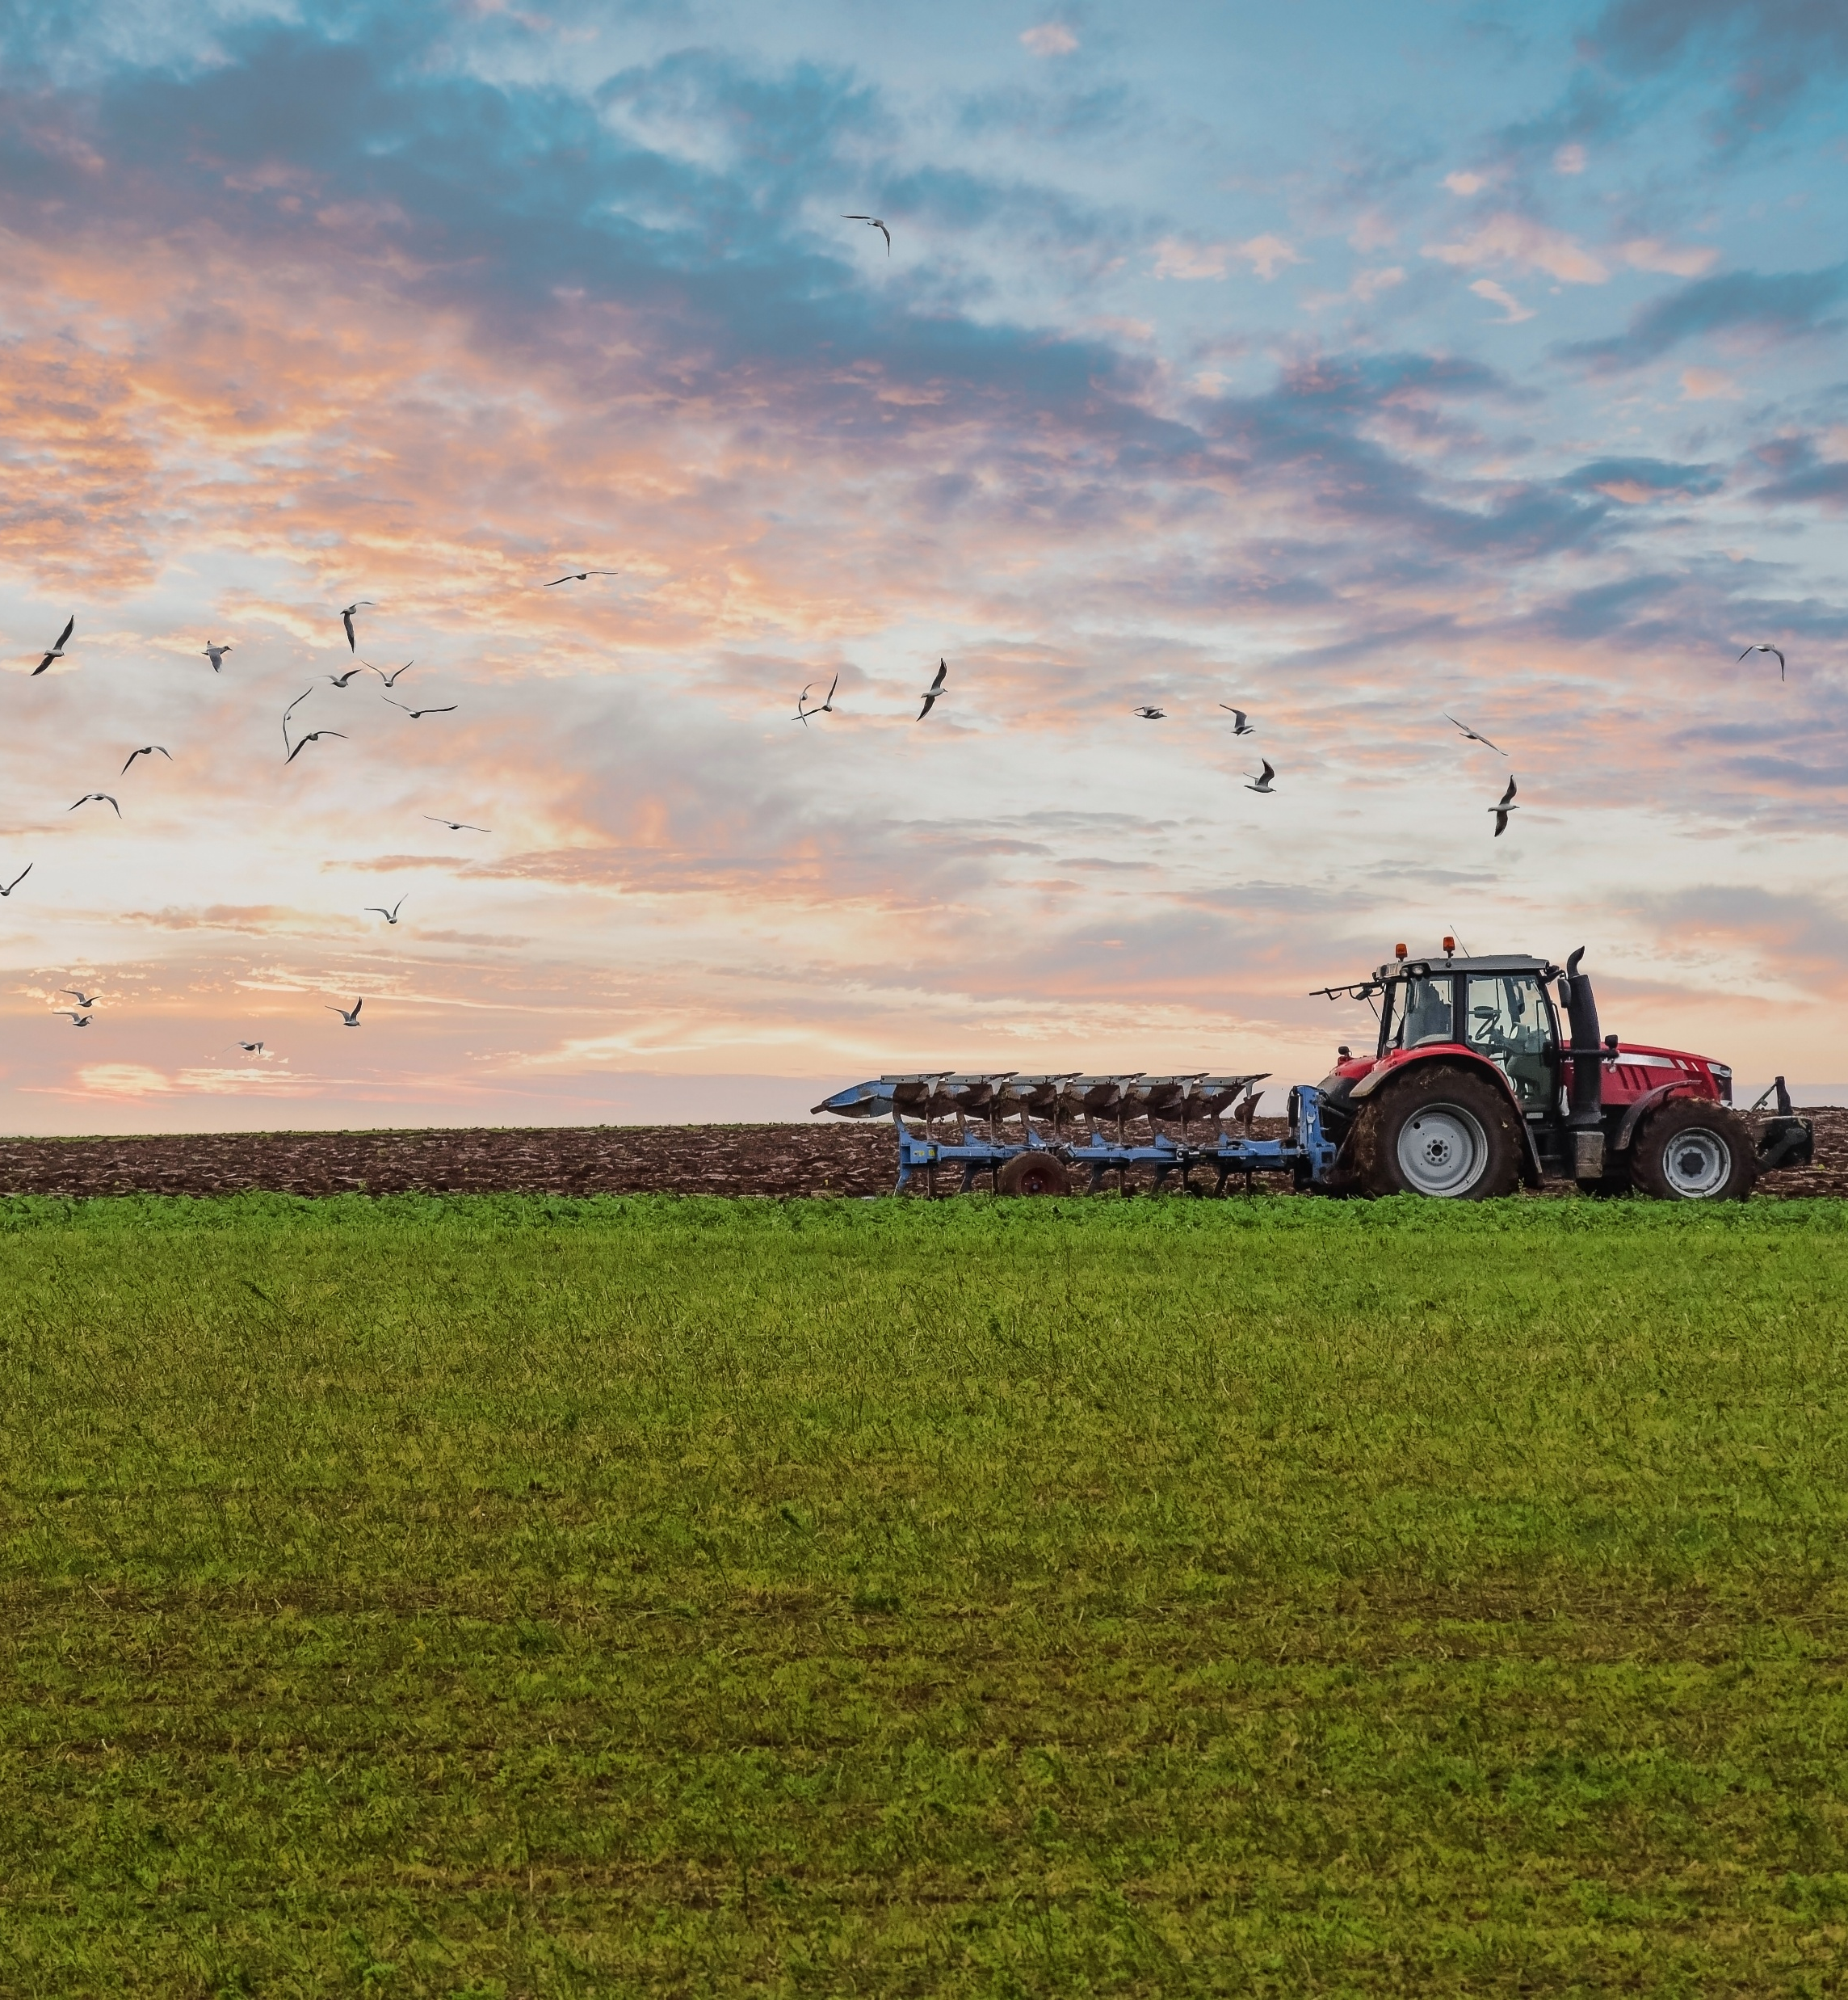



Reviving rural economies
New income streams for farmers, foresters & fishers
New skilled jobs in rural, coastal and de-industrialised regions
Strong local value chains & generational renewal
Works with sugar beet farmers in northern France to convert sugar beet residues into 7 bio-based organic acids for food, fragrances, hygiene products and polymers
80 direct & 200 indirect local jobs
Estimated annual CO₂ reduction: 30,000 tonnes
Supports European grassland farmers by helping them establish small-scale, decentralised green biorefineries
Extract proteins and other high-value compounds from grass and other non-food crops
© AdobeStock
Notes:
Millions of European farmers currently produce biomass, such as agricultural residues, olive leaves, feathers, energy crops that has little or no market value. Biorefineries create demand for this biomass as industrial feedstock, providing farmers with an additional income stream beyond food production.
Biorefineries are by nature place-based industries: they must be built where the biomass is. This anchors jobs in rural, coastal and de-industrialised regions. This is particularly important for regions facing rural depopulation or agricultural income decline.
Unlike many digital economy jobs, biorefinery jobs are in manufacturing, engineering, agronomy and logistics - sectors that provide broad employment across skill levels.
RURAL BIOREFARMERIES example: the project supports European grassland farmers by helping them establish small-scale, decentralised green biorefineries that extract proteins and other high-value compounds from grass and other non-food crops. Farmers become suppliers to bio-based industry, not just food markets — diversifying income and strengthening rural resilience.
AFTERBIOCHEM example: the project is working with local sugar beet farmers in northern France, to convert sugar beet residues into seven bio-based organic acids used in food, fragrances, hygiene products and polymers, and a potassium-rich bio-fertiliser as a circular by-product. The project has created 80 direct and 200 indirect local jobs in a rural area. Estimated annual CO₂ reduction: 30,000 tonnes.
National and regional bioeconomy strategies are crucial for a successful development of the bio-based ecosystem, bringing together biomass providers, innovators and businesses taking up bio-based innovations.
Example: The Grand Est region's bioeconomy strategy aims to transition the region from a fossil-based economy to a sustainable, circular model by capitalising on its rich agricultural and forestry resources. Launched in 2019, the plan seeks to generate green jobs, boost business competitiveness, and support regional decarbonisation.

Slide 7

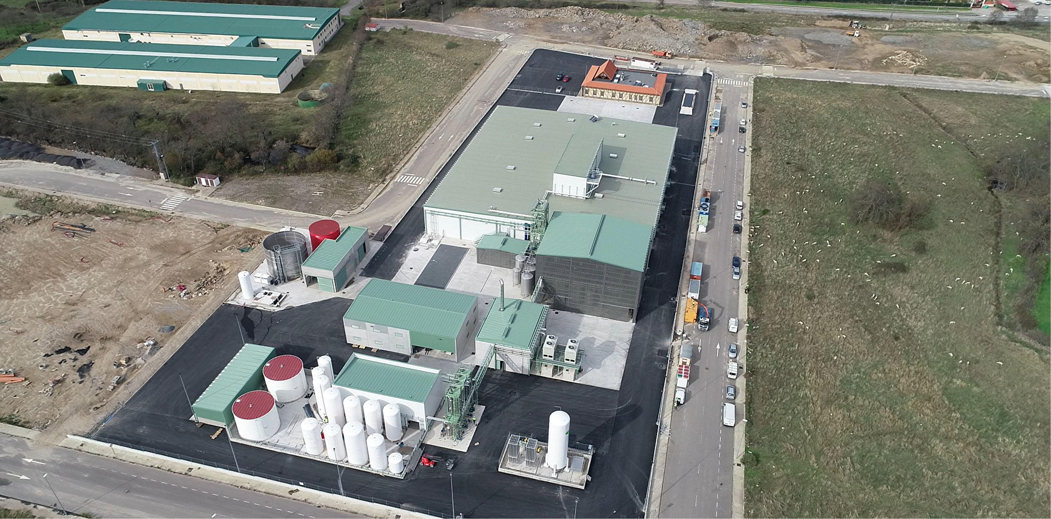


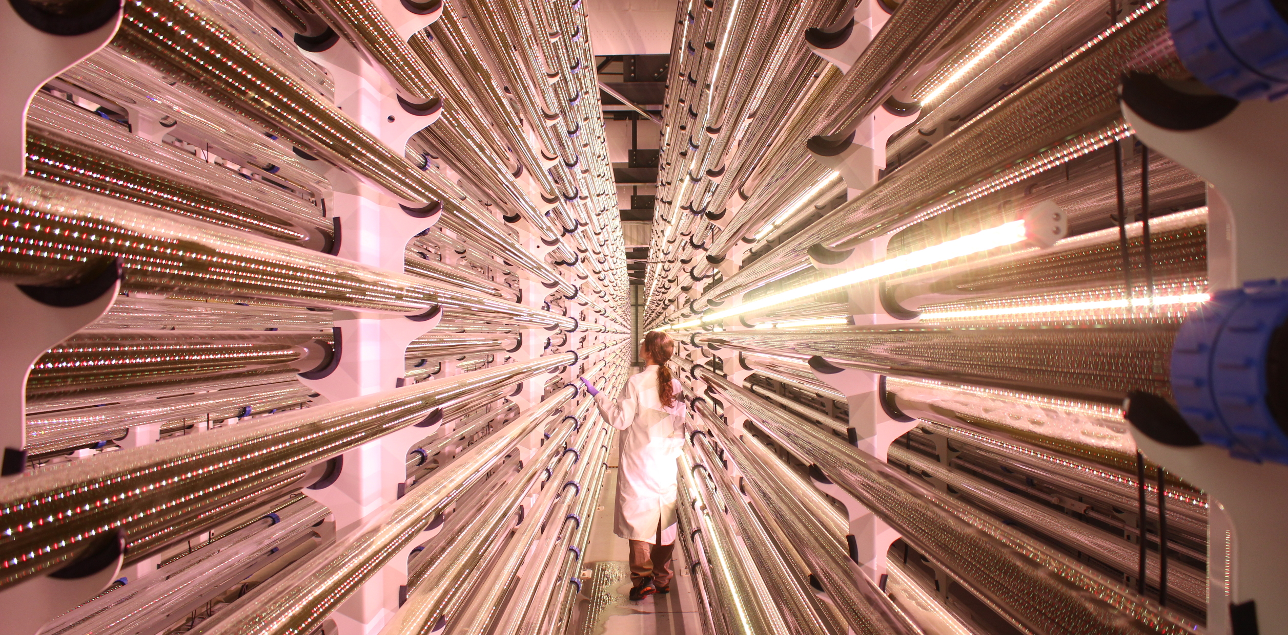

Empowering small businesses across Europe
Participants
2014-2025
Funding
1,860
participants
38%
35%
24%
36%
46
countries
Higher education establishments
Private companies
Small and medium-sized enterprises
    Research centres
    Other
    Universities & research centres
Data: CORDA, May 2026
Notes:
SMEs account for 99% of EU businesses and 85 million jobs.
38% of CBE JU beneficiaries are SMEs. They are important technology providers for the bio-based solutions, and they lead 1/3 of all CBE JU-funded projects.
CBE JU gives SMEs access to co-funding, pilot and demonstration facilities, pan-European consortia, and visibility with industrial buyers and investors.
Across our programme, 199 SMEs introduced new innovations, 240 SMEs launched market-first developments, and SME turnover reached €14.3 billion.
SUSTAINEXT example: Spanish SME NATAC is transforming an old factory in Extremadura into a circular biorefinery. The new biorefinery is extracting high-value compounds from local medicinal and aromatic plants, creating new business opportunities in one of the EU's most rural regions.
SCALE example: - Led by SME MICROPHYT, this project built the world's first fully integrated industrial microalgae biorefinery in Baillargues, southern France. It produces food supplements, cosmetics ingredients and animal feed while capturing CO₂. The biorefinery has created 40 local jobs in a rural area and opened career pathways for young professionals.

Slide 8
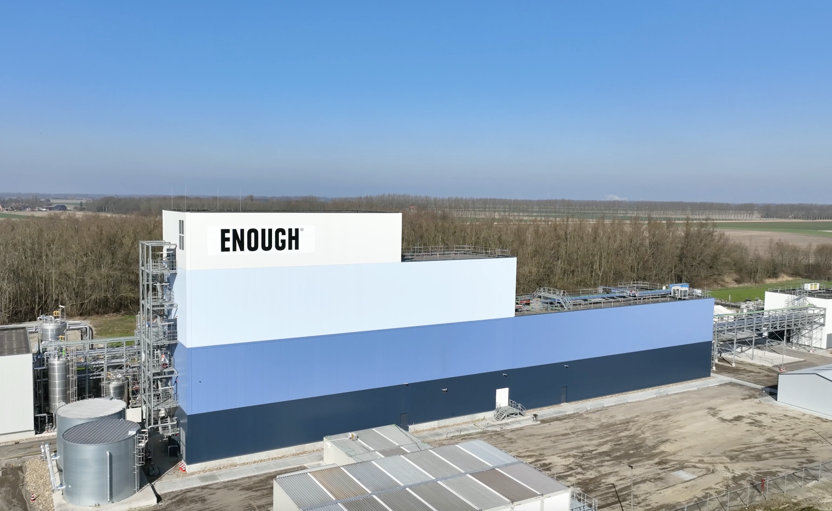

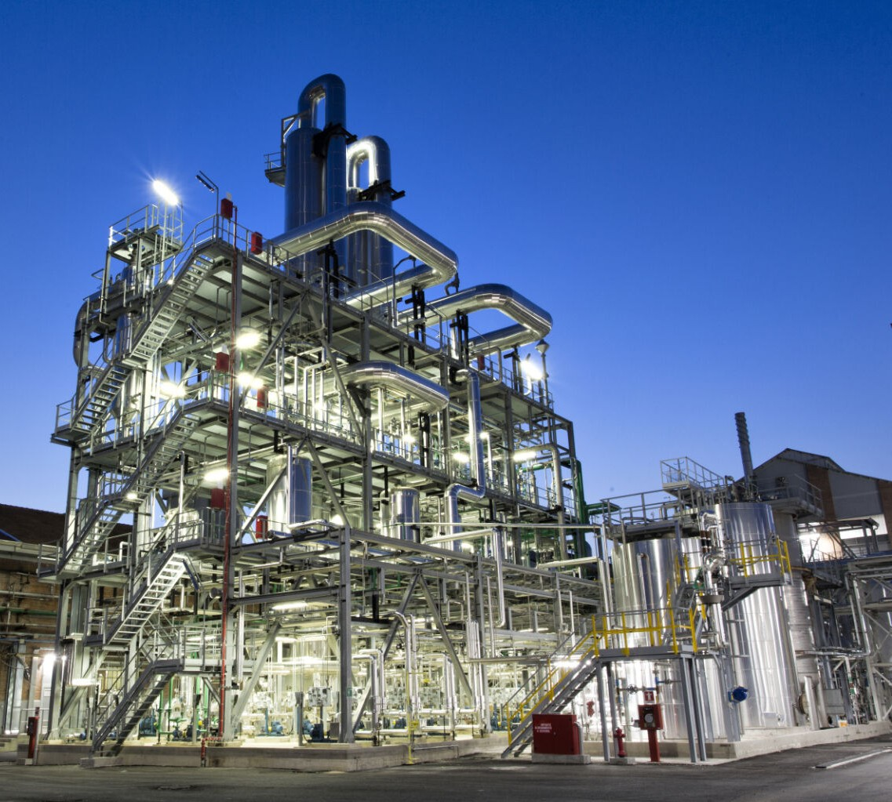


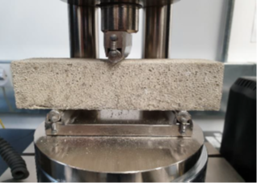
Boosting EU's strategic autonomy
CBE JU helps building European supply chains for materials and chemicals to reduce strategic vulnerabilities.
Self-healing concrete derived
from sewage and waste
Mycoprotein from European agricultural residues,
using fermentation, for meat, fish & dairy alternatives
Notes:
CBE JU helps building European supply chains for materials and chemicals to reduce strategic vulnerabilities.
The EU is heavily dependent on imports not just for fossil fuels, but for many chemicals, proteins, textiles fibres, and specialty materials. Bio-based alternatives produced in Europe from European feedstocks reduce these strategic dependencies.
This is not just an environmental argument, it is about European security and competitiveness.
PLENITUDE example: The EU imports the majority of its soy protein from South America, with major environmental and geopolitical dependencies. PLENITUDE pioneered mycoprotein at industrial scale from European agricultural residues, using fermentation.
DEEP PURPLE example: the project transforms wastewater and sewage sludge, a major urban waste challenge, into feedstocks for bio-based plastics, cosmetics, fertilisers and construction materials using purple phototrophic bacteria.

Slide 9
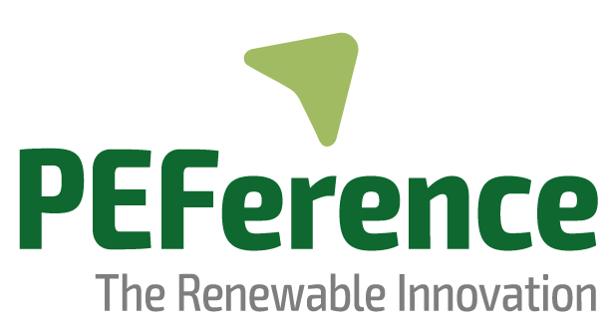
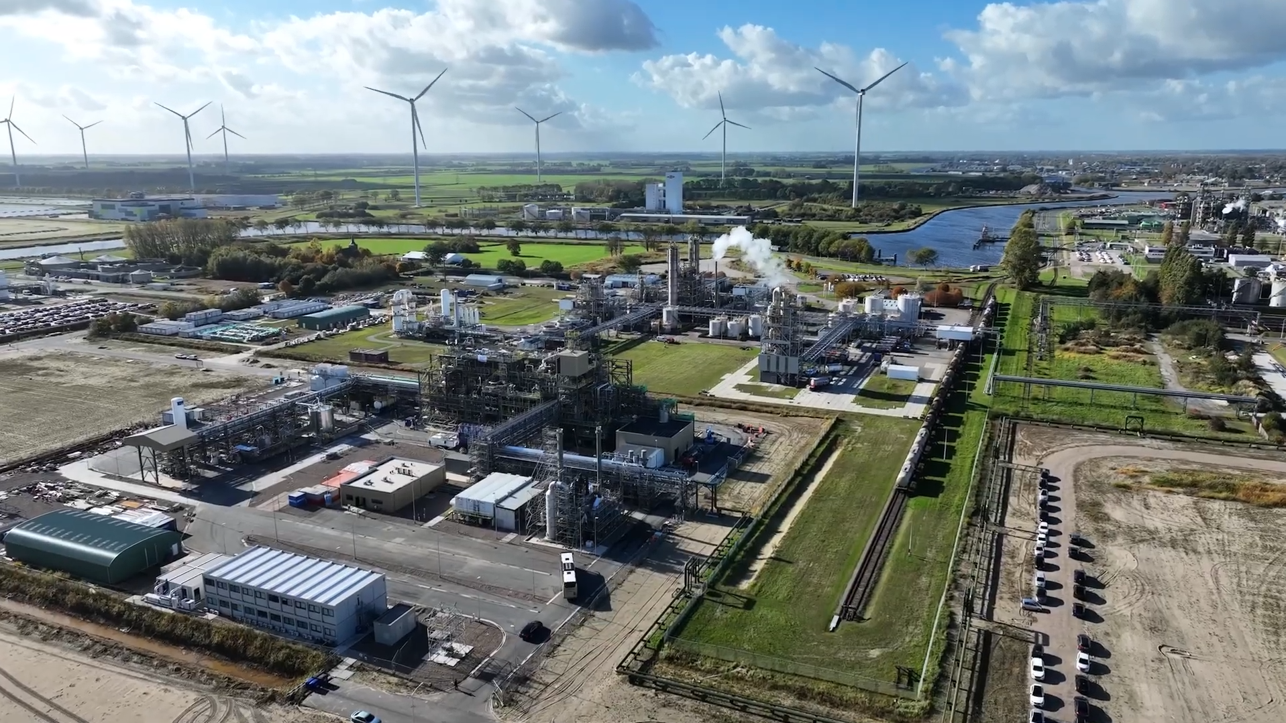
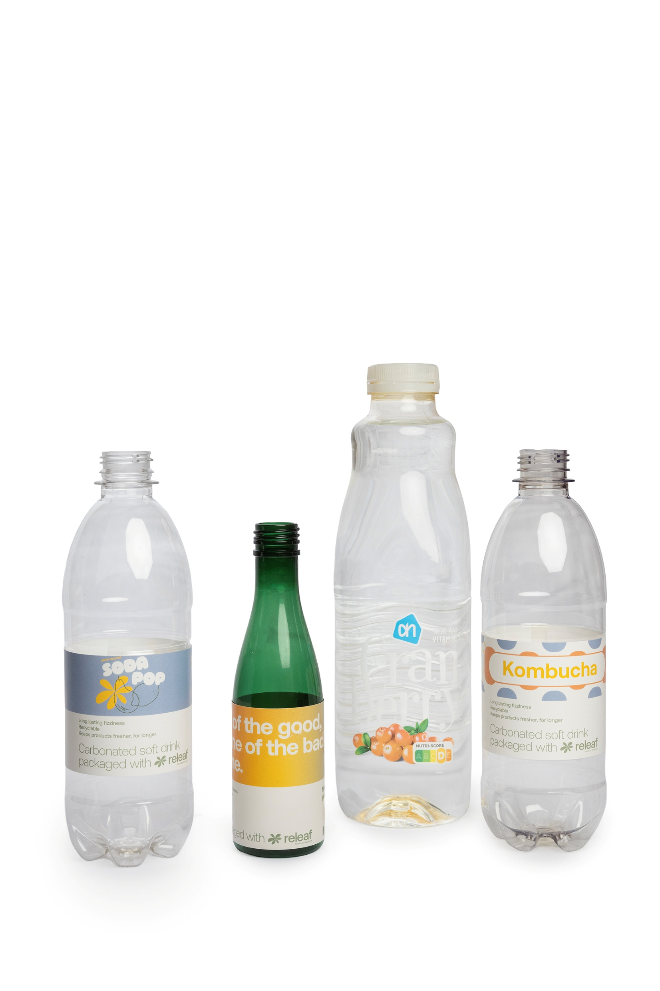

Innovation that reaches the market
Commercial products
Operating plants
Market entries
Bio-based solutions for packaging (Dior)
Beer, juice, wine bottles (Carlsberg, Hoogesteger)
Spacer fabric (Auping mattresses)
Ecover cleaning products from food waste
Notes:
CBE JU funds projects that result in commercial products, operating plants and market entries. Bio-based cleaning agents, food, cosmetics, packaging are no longer prototypes, they are produced at scale and can be found on the supermarket shelves. This validates the economic viability of bio-based solutions, and they compete on quality and cost.
PEFerence example: Since the inauguration of the project’s flagship biorefinery, Avantium, its lead company, has announced several important collaborations on the use of its Releaf® technology for circular bio-based packaging solutions, such as Parfums Christian Dior for primary packaging; Hoogesteger, a leading producer of fresh cold-pressed juices in the Netherlands, for juice bottles; Bottle Collective on innovative fibre bottles; Auping mattresses for spacer fabric. Avantium’s PET/PEF bottle has been recognised as fully recyclable in PET stream both in Europe and Japan and are available at Albert Heijn supermarkets.
WASTE2FUNC example: consumer brand Ecover launched multi-surface and toilet cleaners made from food waste and sold them in Delhaize supermarkets in Belgium.

Slide 10

Supporting EU objectives
CBE JU:
Advances the European bio-based sector
Decarbonises European industries
Creates new European industrial value chains
Reduces imports by developing European alternative proteins
Enables SMEs to scale with access to infrastructure and funding
Pioneers industrial-scale solutions for algae and aquaculture
Offers new revenue streams for farmers, provides solutions for sustainable agriculture
Strengthens EU biomanufacturing capacity
EU Bioeconomy Strategy
Clean Industrial Deal
EU Competitiveness Compass
EU Protein Strategy
EU Startup & Scaleup Strategy
European Ocean Pact
Vision for Agriculture and Food
Life Sciences Strategy
Notes:
CBE JU delivers across the full spectrum of EU strategic priorities:
EU Bioeconomy Strategy - advancing the European bio-based sector.
Clean Industrial Deal - decarbonising European industries.
EU Competitiveness Compass - creating new European industrial value chains.
EU Protein Strategy - reducing imports by developing European alternative proteins.
Startup & Scaleup Strategy - enabling SMEs to scale with access to infrastructure and funding.
European Ocean Pact - pioneering industrial-scale solutions for algae and aquaculture.
Vision for Agriculture and Food - new revenue streams for farmers, providing solutions for sustainable agriculture.
Life Sciences Strategy - strengthening EU biomanufacturing capacity.

Slide 11
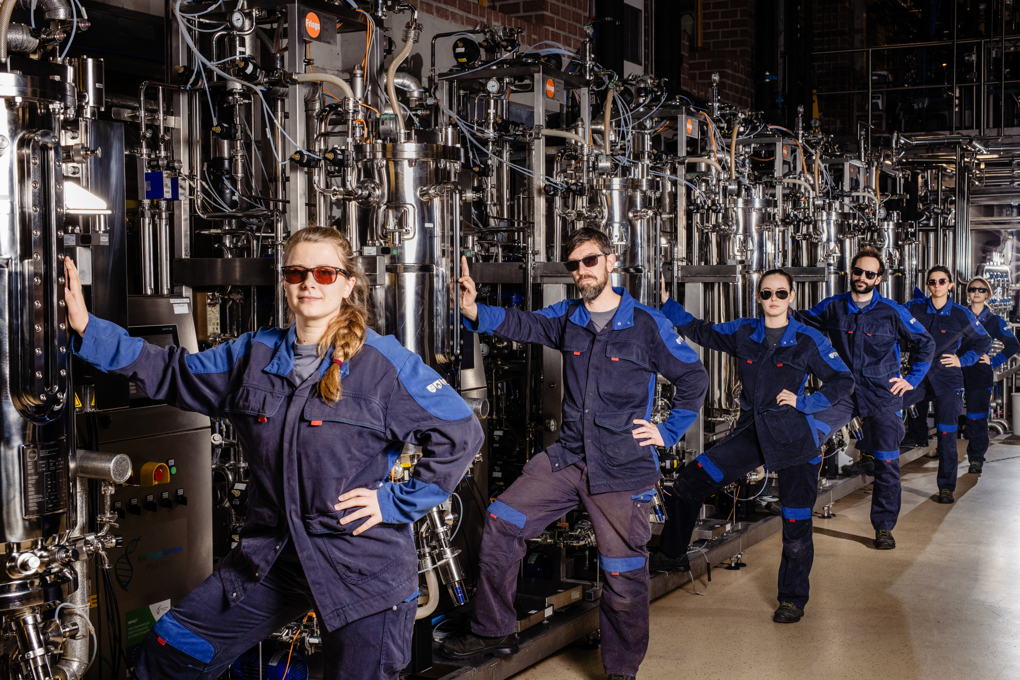
Next: addressing the sector’s challenges
CBE JU stakeholders’ view:
Scaling is the main challenge, not innovation
Regulation must enable markets
Access to finance across all stages is critical
Strong value chains and collaboration are key
Market creation and competitiveness need urgent attention
Accelerating the transition from demonstration to market deployment
© Sanne De Block for BBEPP
Notes:
Although the bio-based innovation is booming in Europe, several challenges hamper its successful deployment. These were identified by CBE JU stakeholders during the recent forum in March 2026:
Scaling is the main challenge, not innovation
Moving from pilot and demo to industrial scale (second valley of death) remains the biggest hurdle. Many promising innovations fail to reach commercial scale due to the reluctance of investors. Addressing this gap requires targeted financial instruments, risk-sharing mechanisms and policy support to enable large-scale deployment and replication.
Regulation must enable markets
Clear, stable and aligned regulatory frameworks are essential. Beyond compliance, regulation and public procurement can actively create demand, reduce risk and accelerate market uptake of bio-based products.
Access to finance across all stages is critical
While early-stage funding is strong, major gaps remain in scale-up and commercial deployment. To address this, Europe needs to maintain financial instruments like CBE JU to sustain the effort in innovation and ensuring a pipeline of scalable technologies. Simultaneously, it should develop innovative blended finance and risk-sharing instruments and provide a stable, predictable policy frameworks that gives investors’ confidence in future market demand.
Strong value chains and collaboration are key
Successful projects depend on integrated ecosystems: linking farmers, industry, investors, researchers and policymakers. Collaboration across sectors and regions is essential to ensure feedstock security, market access and scalability.
Market creation and competitiveness need urgent attention
In the current geopolitical context, marked by supply chain vulnerabilities and global competition, bio-based products must compete with both fossil-based alternatives and lower-cost international producers. Strengthening Europe’s position requires targeted market pull measures, enhanced consumer awareness, cost reduction strategies and strategic infrastructure investments to secure resilient and competitive bio-based value chains.
Accelerating the transition from demonstration to market deployment
The sector must move beyond innovation and focus on delivering industrial-scale solutions. This requires embracing risk, learning from experience, using data and AI effectively and accelerating action to support Europe’s resilience and strategic autonomy.

Slide 12


