Slide 1
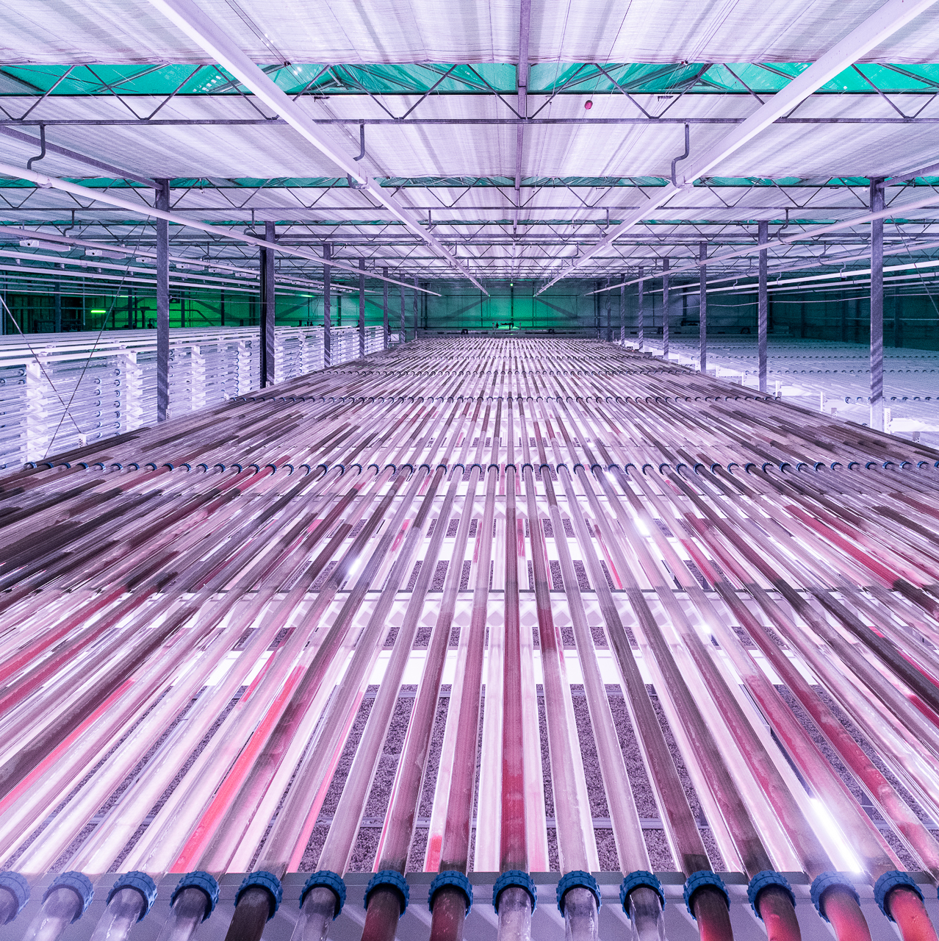
CBE JU:
supporting EU policies through circular bio-based solutions

Slide 2
Transforming EU policy into bio-based impact
CBE JU:
Translates EU policy priorities into market-ready circular
bio-based solutions
Bridges the gap from research to industrial production
Delivers industrial-scale biomanufacturing and market-ready bio-based products
Pools public–private investment to strengthen EU competitiveness
Builds sustainable, circular value chains across Europe
€1700 organisations
supported since 2014
38% of them are SME’s
23 first-of-their-kind flagship biorefineries enabled
198 demonstration plants enabled

Slide 3
Delivering on the European Commission’s political priorities (2024–2029)
CBE JU contributes to:
Clean industries
Circular economy
decarbonising industry
transforming waste & sidestreams
EU competitiveness & strategic autonomy
reducing dependency on fossil imports
Innovation & scale-up
bringing technologies to market

Slide 4
CBE JU contributes to:
Digital transformation
Sustainable food systems
Blue economy
creating bio-based solutions from algae & aquaculture
building smarter, more efficient biorefineries & future-ready jobs
developing new proteins, ingredients & circular agri-food value chains
Sustainable agriculture
offering new income sources & sustainable solutions to farmers

Slide 5
CBE JU-funded projects in numbers
2014-2026
Participants
Funding
243
projects
1,860
participants
38%
35%
1.45 billion
invested in projects
24%
36%
46
countries
Higher education establishments
Private companies
Small and medium-sized enterprises
    Research centres
    Other
    Universities & research centres
Data: CORDA, May 2026

Slide 6

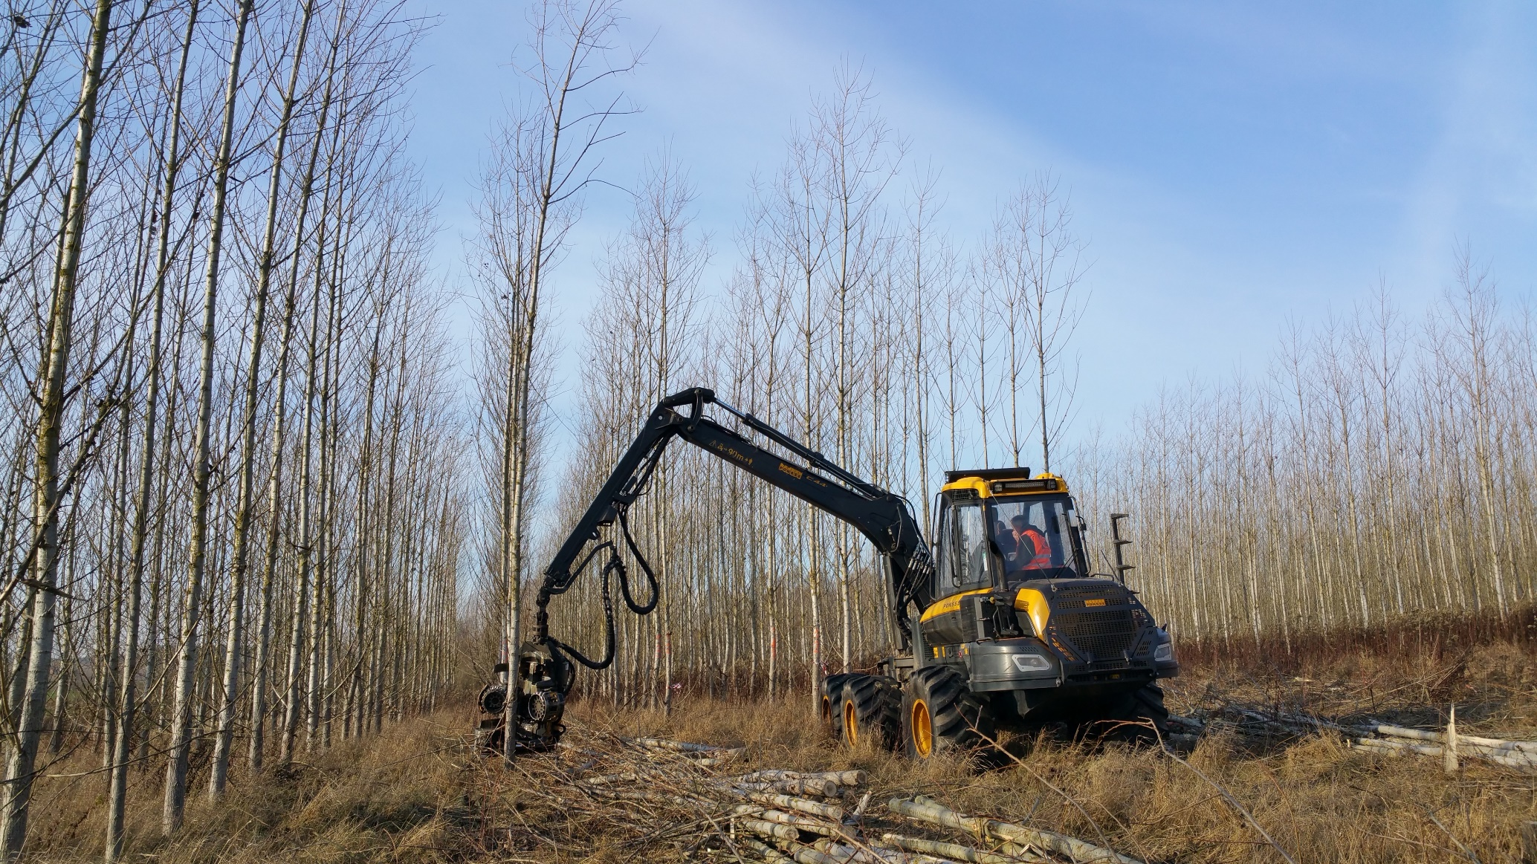


Transforming investment into impact
Impact example:
CBE JU de-risks first-of-their-kind projects that struggle to secure financing
For every €1 EU funding, CBE JU attracts €3.62 in private investment
Keeps strategic bio-based investments in Europe
Creates replicable industrial models for Europe-wide deployment
Empowers SMEs and start-ups
Led to a €700 million private investment for a commercial-scale biorefinery in Latvia
Pioneered innovative recycling and biorefinery technologies in Italy, enabling replication across multiple sites
Created local jobs through a pioneering sugar-beet-based biorefinery in France

Slide 7



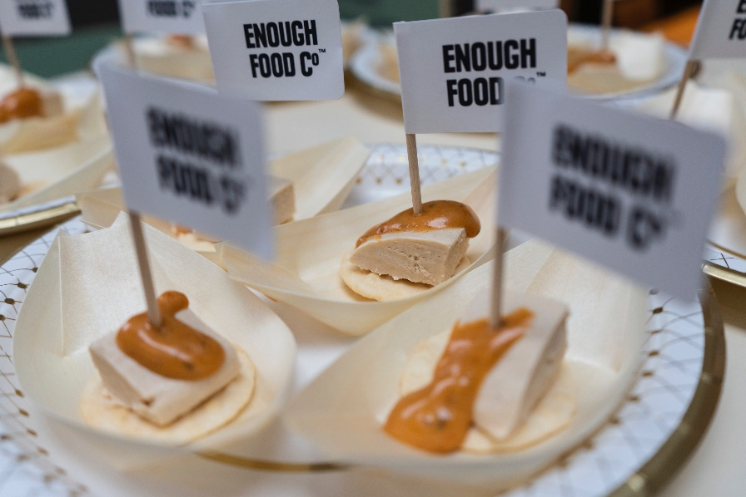
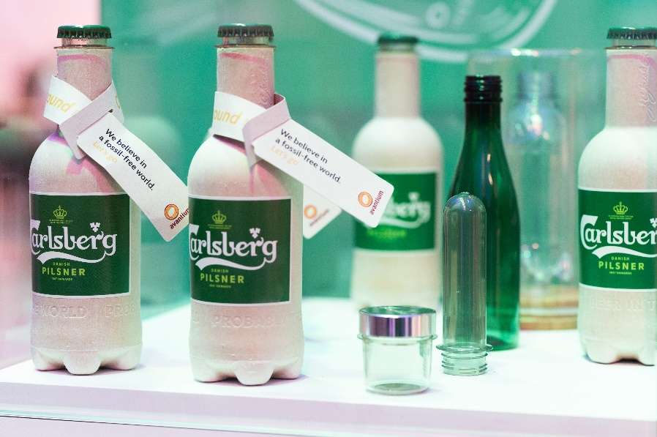
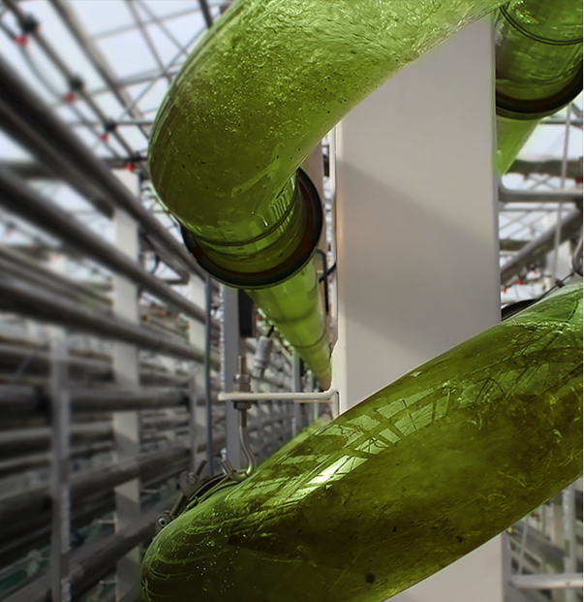
From lab to market-ready bio-based solutions
CBE JU:
Drives Europe’s biomanufacturing capacity with 25 first-of-their-kind industrial-scale flagship biorefineries & 198 demonstration plants
Demonstrates that bio-based solutions are viable, scalable & competitive
Reduces greenhouse gas emissions & resource use
Strengthens local supply chains & create jobs
Low-impact protein production
100% bio-based, recyclable plastics
Industrial microalgae biorefinery capturing CO₂

Slide 8
Real impact for Europe
CITIZENS
BUSINESSES
REGIONS
Sustainable packaging, cleaning products, food ingredients & consumer goods
Cleaner industries with lower emissions
Sustainable farming solutions that restore biodiversity & soil health
Lower investment risks for innovative technologies
New market opportunities in fast-growing sectors
Resilient local supply chains
New jobs & skills in rural & coastal areas
New income streams for farmers, foresters & fishers
Strong local value chains & generational renewal

Slide 9
